Slide 1

Regional Centre Training Institute
SYSTEM OVERVIEW
Our new website and online admissions: what it does, and how it keeps information safe
Presentation to staff and partners
Notes:
Good morning. Today I will show you our new website and online admissions system: what visitors see, how people apply, how staff run it, and how we keep everyone’s information safe.

Slide 2




One system, three parts
Public website
Applicant area
Staff area
For visitors and prospective students
For people applying
For institute staff
Pages, news and programmes
Short courses with fees and dates
Opens in the visitor’s own language
Apply online in about 15 minutes
Send documents and fee payment by phone
See progress and accept the offer online
Update the website without a technician
Check applications and send offers
Each person sees only what their job needs
All connected. When staff make a change, it appears on the website straight away.
Notes:
The system has three parts. Visitors use the website to learn about us. Applicants use their own area to apply and follow their application. Staff use the staff area to run the website and admissions. Everything is connected, so when staff change something, the website shows it straight away.

Slide 3
The public website
01
Easy for staff to update, easy for visitors to use
Notes:
Let us start with the website that the public sees.

Slide 4
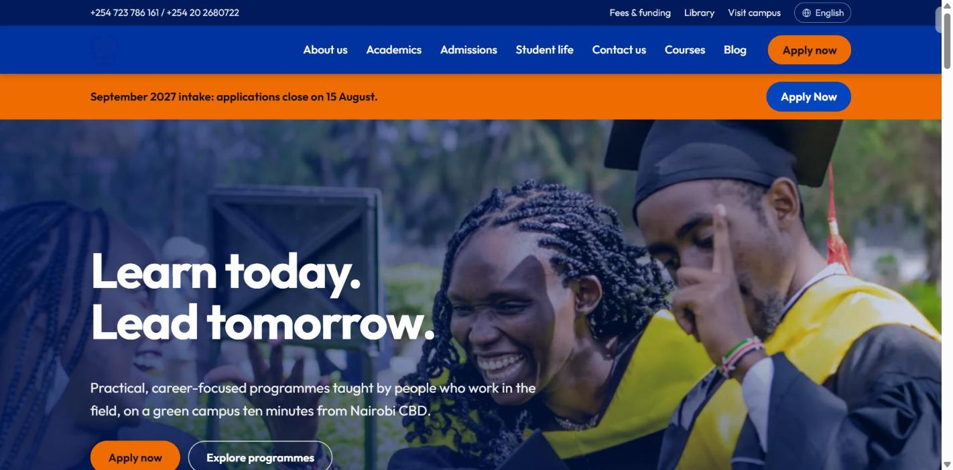




Staff can update the website themselves
Ready-made sections
Banners, photo galleries, videos, maps, questions and answers
Check before it goes live
Changes can be reviewed, approved, and timed to appear later
News and stories
Share events and success stories, with photos
Photo library
Photos are made smaller by themselves, so pages open fast on phones
Notes:
Staff can update the website themselves, without calling a technician. Pages are made from ready-made sections, like banners, photo galleries and maps. Changes can be checked and approved before they appear, and can even be timed to appear on a certain date.

Slide 5
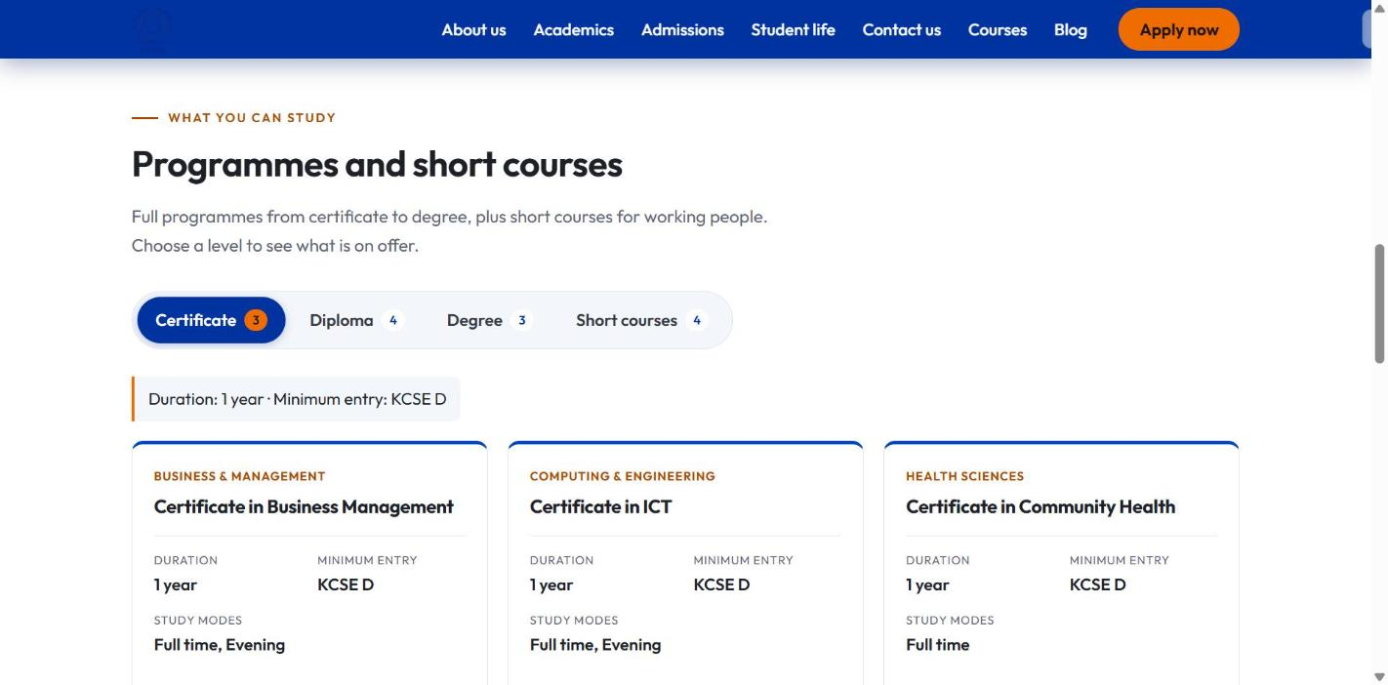



Course lists stay up to date by themselves
Courses are typed in once. The website and the application form always show the same list.
Sorted by level
Certificate, Diploma, Degree and Short courses
Grouped by subject
Business, Computing and Health
Short courses
Fee, class times, start date and an Enquire button
Notes:
Courses are typed in only once. The website and the application form both use that same list, so they never disagree. Short courses show their fee, class times and next start date, and old dates disappear by themselves.

Slide 6
Open to applicants across the region
4
20
languages
RCMRD member countries
English, Kiswahili, Luganda and German: the site picks the visitor’s language by itself
Listed first when applicants choose their country
100
100
out of 100 for accessibility
out of 100 for Google
Easy to use, including for people with disabilities
Easy for people to find us when they search
Notes:
The website is made for the whole region. It opens in the visitor’s own language: English, Kiswahili, Luganda or German. The 20 RCMRD member countries are listed first on the application form. It also scores full marks for being easy to use and easy to find on Google.

Slide 7
Admissions, end to end
02
From “Apply now” to an offer letter, all online
Notes:
Next, admissions: this is where the system saves staff the most time.

Slide 8




Applying online, step by step
1
2
3
4
5
6
7
8
Create account
Choose a course
Personal details
Next of kin
School results
Funding
Documents
Check and send
The form checks for you
Saved as you go
Minimum age
Entry grades
Pay by M-Pesa
Stop and come back at any time
Applicants must be at least 16 years old
Grades below the entry level are pointed out to staff
Applicants enter the M-Pesa code; staff confirm it
Notes:
Applying takes about fifteen minutes, in eight simple steps, and the form saves as you go. The form also checks things for you: applicants must be at least 16, low grades are pointed out to staff, and the fee is paid by M-Pesa.

Slide 9

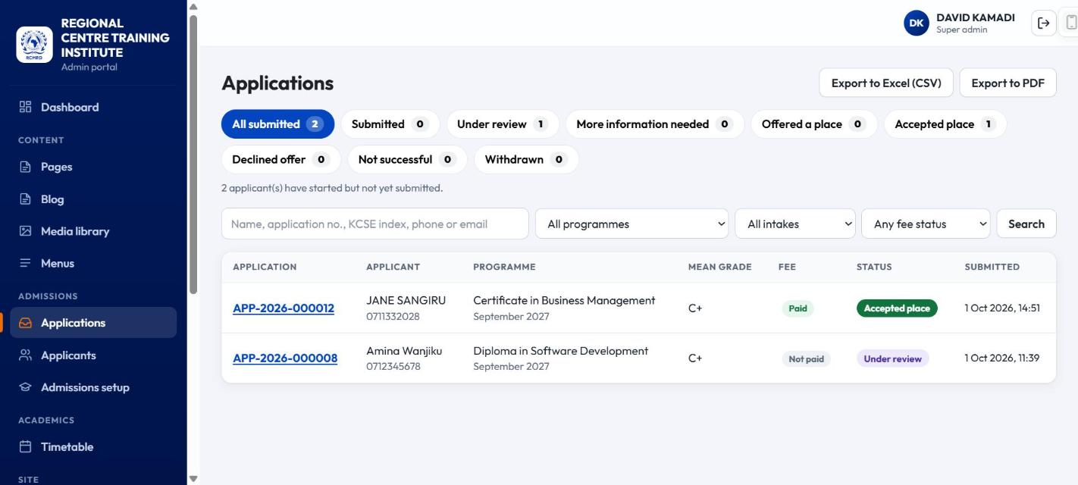



From application to decision
Everything in one list
Each application shows its stage: new, being checked, offered, accepted
Check documents and fees
Approve each document and confirm each payment
Applicants kept informed
They see every update when they sign in
Print or download
Get the list as an Excel sheet or a printable PDF
Notes:
Staff see all applications in one list, with each one’s stage. They check documents and confirm payments, then decide. Applicants see every update when they sign in. The list can be downloaded as an Excel sheet or printed as a PDF.

Slide 10
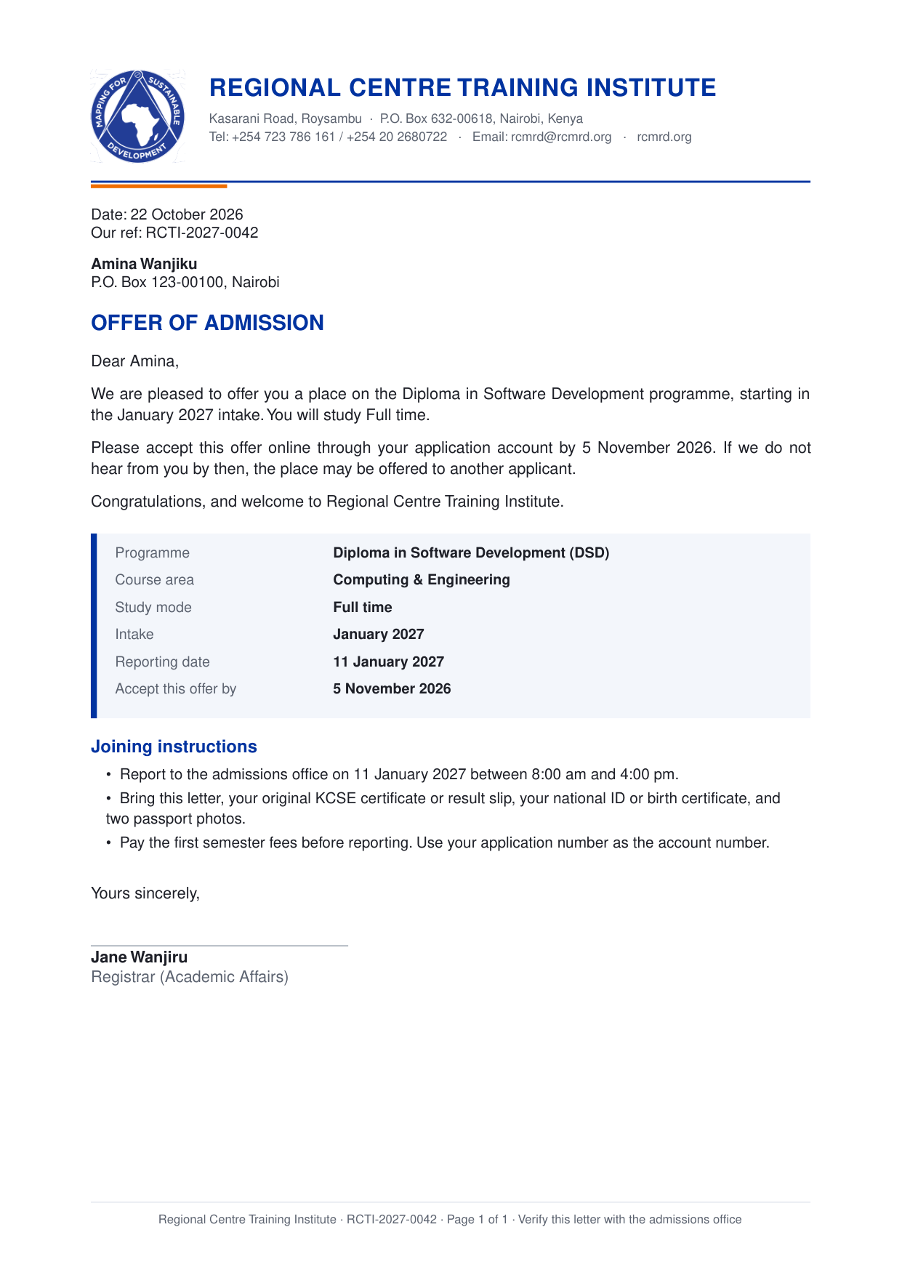



Professional letters, made automatically
Offer of admission
Created automatically when a place is offered. The applicant downloads it and accepts online.
Applications report
A printable summary of all applications, ready for meetings.
Same official letterhead
Every document carries the RCMRD logo, our name and our contact details.
Notes:
When we offer someone a place, the offer letter is created automatically on our official letterhead. The applicant downloads it and accepts online. Reports for meetings are printed on the same letterhead.

Slide 11
The staff area
03
One place to run everything, and each person sees only what they need
Notes:
Now the staff area, and how we control who sees what.

Slide 12
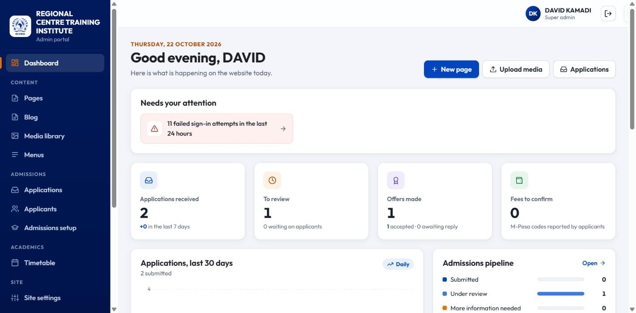
The staff area at a glance
Website
Pages
News
Photo library
Menus
Site settings
Languages
Website wording
Admissions
Applications
Applicants
Admissions setup
Teaching and staff
Timetable
Staff accounts
Who sees what
Activity record
Notes:
When staff sign in, the first page shows what needs attention, such as new applications or payments to confirm. All the tools are in one menu, and each person only sees the tools their job needs.

Slide 13
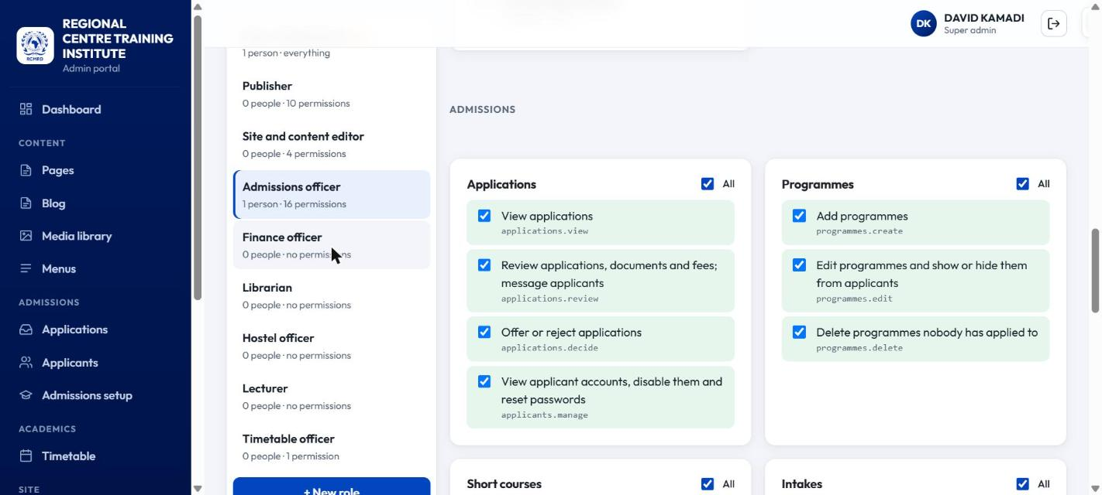




Each person sees only what their job needs
Simple tick boxes
Choose exactly what each job may see and change
A role for every job
For example, admissions staff see only admissions
Changes apply at once
And every change is written down in the activity record
Applicants kept separate
Applicants can never get into the staff area
Notes:
We decide what each job may see and change using simple tick boxes. For example, admissions staff see applications but cannot change the website or staff accounts. Changes apply straight away and are written down. Applicants can never get into the staff area.

Slide 14
Keeping information safe
04
Several layers of protection for staff and applicants
Notes:
Finally, how we keep information safe.

Slide 15





Protecting every sign-in
Strong passwords
A code from your phone
Stops password guessing
At least 12 characters; easy-to-guess passwords are refused
Staff also type a code from an app on their phone
After 5 wrong tries the account locks for 15 minutes
Automatic sign-out
One device at a time
No fake requests
Staff are signed out after 15 minutes away from the screen
Signing in elsewhere signs out the other device, with a warning
Other websites cannot make changes pretending to be you
Notes:
Signing in is protected in several ways. Passwords must be strong. Staff also type a code from their phone, so a stolen password is not enough. After five wrong tries the account locks. Staff are signed out when they leave the screen, and can only be signed in on one device at a time.

Slide 16
Protecting personal information
Personal data
On the website
Applicants only ever see their own application
Uploaded documents are private, never public
Every upload is checked before it is accepted
Harmful content is removed before it is saved
Staff see only what their role allows
Harmful code from other places is blocked
Only trusted video and map services can appear
Other websites cannot copy or disguise our pages
Always a secure connection (the padlock in the browser)
Never asks for the camera, microphone or location
Notes:
Personal information is protected. Applicants can only see their own application, and their documents are never public. Every upload is checked. On the website itself, harmful code is blocked, and the connection is always secure.

Slide 17



A record of everything, and a safety net
Activity record
Backups
Safe to switch on
Who signed in, and every failed attempt
Every change made by staff
Search by person, action or date
Copies of all information and files
Tested to make sure everything can be brought back
Planned every night, with a copy kept elsewhere
Will not go live with unsafe settings
Checks that staff phone codes are switched on
Checks that passwords and keys are strong
Notes:
Everything important is written down in an activity record, so we can always see who did what. All information is backed up, and we have tested that it can be brought back. The system will also refuse to go live if anything is set up unsafely.

Slide 18
Tested and checked
100
100
100
Easy for everyone
Built properly
Easy to find
Accessibility score, out of 100
Quality score, out of 100
Google-readiness score, out of 100
85–90
0
80+
Fast
Known weaknesses
Automatic checks
Speed score on a slow phone connection
In the software it is built on
Run every time something changes
Notes:
The system has been tested, not just built. It scores full marks for being easy to use, built properly and easy to find, and it is fast even on a slow phone connection. More than eighty automatic checks run every time something changes.

Slide 19

Next steps
Before launch
At launch
After launch
Move to a secure live server
Secure padlock on our web address
Nightly backups kept in a second place
Independent security check
Add the real courses, intakes and fees
Translate pages into Kiswahili, Luganda and German
Create staff accounts with the right roles
Phone codes set up for every staff member
Pay fees with an M-Pesa pop-up on the phone
Email and SMS updates to applicants
An area for current students
Regular checks of who has access
Notes:
Before we launch, we move to a secure live server and set up nightly backups and an independent security check. At launch we add the real courses and staff accounts. After launch, we plan M-Pesa pop-up payments, email and SMS updates, and an area for current students.

Slide 20
Thank you
Questions and discussion
Kasarani Road, Roysambu · P.O. Box 632-00618, Nairobi · rcmrd@rcmrd.org
Notes:
Thank you. I am happy to answer questions, or to show you any part of the system.

